Slide 1
Reputation Management System
Mihai Damaschin Matthijs Dorst Maria Gerontini Cihat Imamoglu
Caroline Queva

Slide 2
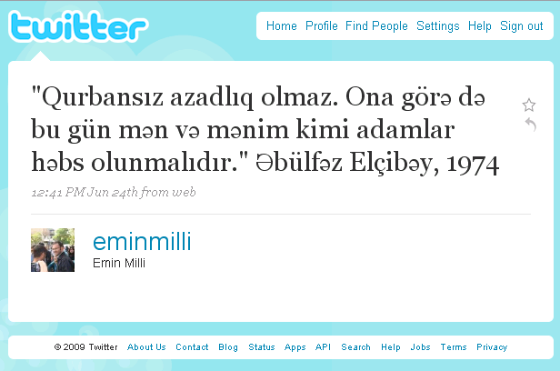
Introduction
Before :
Now :
I like this company, and you ?
I like this company, it’s a really good one. You should try ! It’s awesome !
No I don’t, I think it’s not a good one.
Someone
Difficult to track reputation of a brand.
Can know the reputation of a brand by monitoring social media sources

Slide 3
Methods
Search
Search for specific keywords : provided by Twitter
Problem : their in-memory solution is limited to the last 8 days
To handle this problem, store the search results in a MySQL database.
Query the database as well as the Twitter search.
Increase recall.
Don’t use a relevance score based on term frequency
and document frequency, since tweets are limited in length.

Slide 4
Methods : Get tweets
Need to retrieve data about the tweets : Twitter offers access to most of the functionalities required through a REST API.
Tweet text
Author
Number of followers
Number of retweets
…
I like this company, it’s really good.
Twitter API
Someone
Problem encountered : the rate limit imposed by the API (150 calls per hour, when not authenticated and 350 otherwise).
Solution found : caching.
But still a problem for the calculation of PageRank (can’t create a user graph)

Slide 5
Methods :
Preprocessing : To achieve better results with lee noise
Elimination of repeated characters in tweets
Greeeaaaat Greeaat
Aweeesome Aweesome
Look Look
Annotations and URL’s removal
@Someone : it’s awesome. Check www.this.com.
: it’s awesome. Check.
Tokenization : Use StandardTokenizer from Lucene (Apache)
Send
to
this@mail.com
This
is
perfect
Send to this@mail.com. This is perfect.
Tokenizer

Slide 6
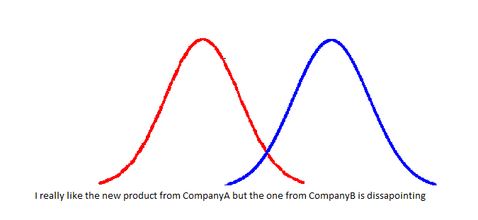
Methods : Sentiment analysis
Lexicon : find the score of a tweet to label it as negative, neutral or positive.
Standard lexicon
“It is good” => score = 0+0+1 = 1
Modifiers and negations : add a coefficient for the following words
“It is not good” => score = 0+0+0+(-1)*1 = -1
Distance : the score decreases as the distance between the sentiment word and the name of the company increases
“I like A but I really hate B” => Positive score for A, negative score for B

Slide 7
Methods
Naïve Bayes:
Use the algorithm provided by Weka and the hand-classified data provided by Sanders Analytics
Extract the tweet content
Transform it into a feature vector
Train the model with the extracted annotated data
Serialize the model

Slide 8
Methods
Use number of retweets, number of followers, friends and other tweets of the author
Use information about the maximum of such numbers
Use log of the features and a simple linear mixture
Obtain a single number representing authority
PageRank: Static quality measure.
Problem encountered : the rate limit imposed by the API is a problem for the creation of a user graph. Consequently, it was not possible to apply the original pagerank algorithm.

Slide 9
Methods: User Interface
Goal : keep the design as simple and self explanatory as possible, while maintaining the essential functionality
Search Input
No distractions: the user is presented with a single text input field and a single button.
Search Results
Overall: pie chart with breakdown of positive, negative and neutral tweets.
Timeline: incremental sentiment over time.
Specific: most influential tweets.

Slide 10
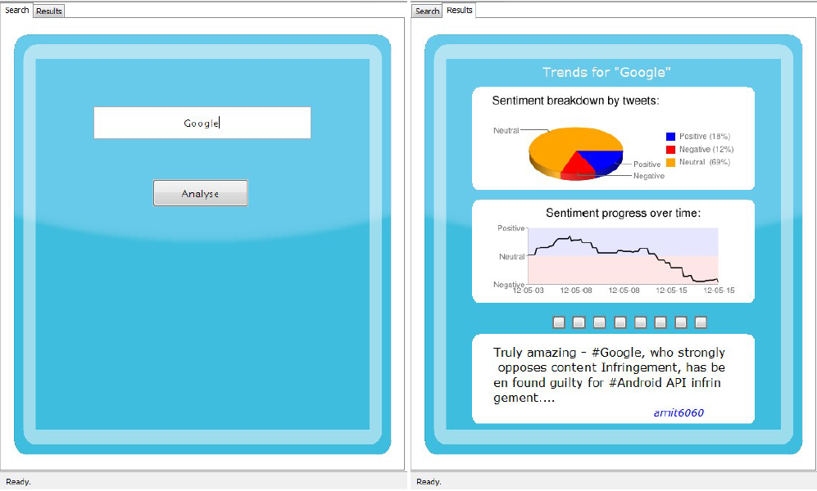
Methods: User Interface

Slide 11
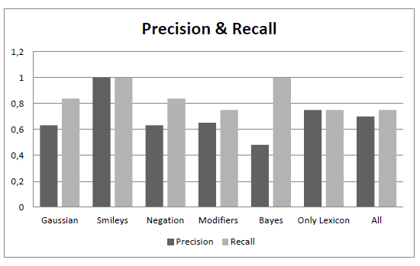
Results
Experimental Set up:
Use an existing twitter corpus, provided by Sanders Analytics
Split this data set for training and testing
Measure precision and recall
Use the query “Microsoft” for testing
Four different ways have been used for the sentiment estimation :
The Gaussian distance.
The detection of negations and modifiers.
The Bayes classifier and a lexicon with assigned negative and positive scores.
The presence of smileys to the sentiment score.
Results for unfiltered data

Slide 12
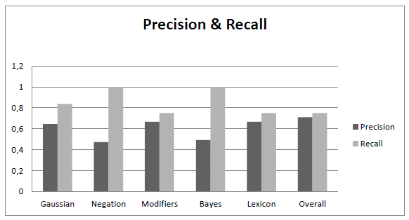
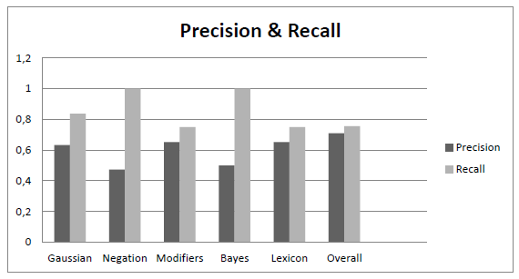
Results
A significant improvement occurs at recall for the negations and the modifiers.
The performance of precision has been decreased.
Results for data without URL and annotations
The Bayes classifier does not indicate any difference.
The overall score has an improvement in comparison with the unfiltered data.
Results for data without repeated characters

